Slide 1
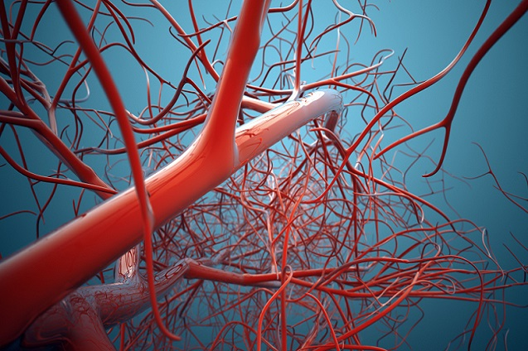
Post Fellowship Study Day
27th March 2015
Cheltenham
Part 1: Medicine and the Law
Part 2: Vascular Anaesthesia
Sandford Education Centre
Registration 0930
Lectures Start 1000
Lunch will (hopefully) be provided and we will expect a prompt 4pm finish
A timetable and details of lectures will follow but if you would like more information please contact the Cheltenham PFSD organisers:
Tom Knight, Toby Jacobs, Tim Cominos, Tom Barrett, Stuart Younie

